Slide 1

Web Applications
Chris Piech
CS106A, Stanford University

Slide 2
For the first time ever in CS106A

Slide 3
[suspense]

Slide 6
Final Assignment

Slide 7
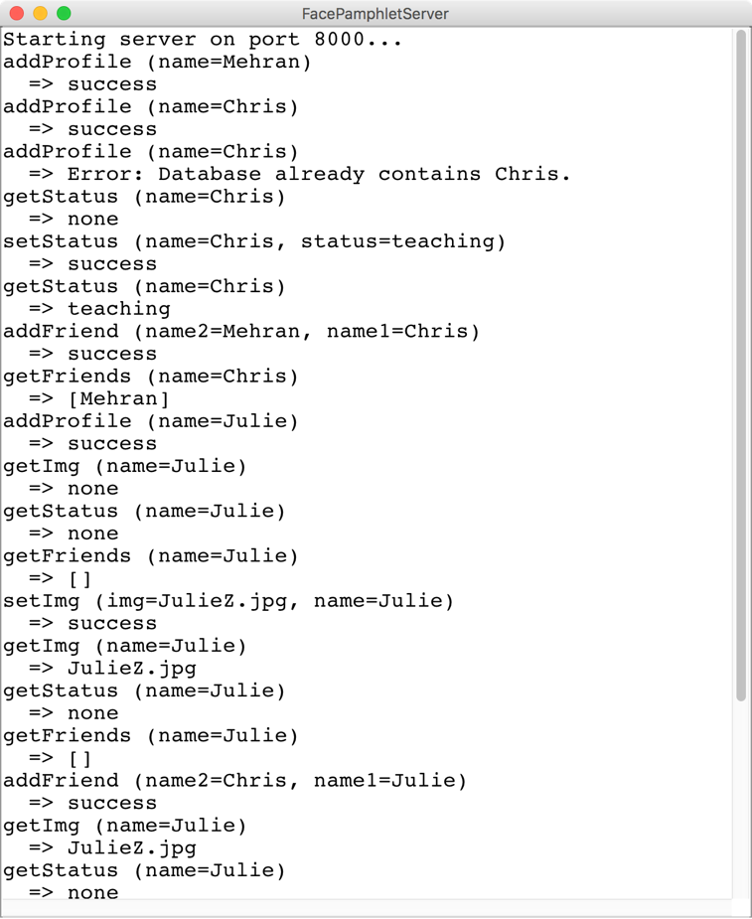
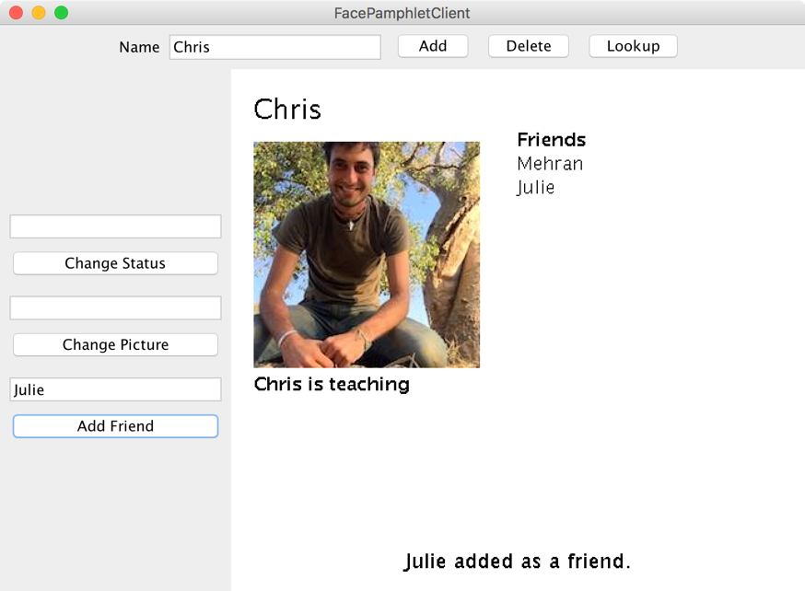
Usahidi
SteamTunnelServer
SteamTunnelClient

Slide 8
Ushahidi
(testimony)

Slide 9
Ushahidi
(testimony)

Slide 10
Shahidi
(whitness)

Slide 12
The Name

Slide 13
Question
How could users could join different SteamTunnels but still connect to one another.

Slide 14
Review

Slide 15
Background: The Internet
The internet is just many programs sending messages (as Strings)
Thanks Nick for the teaching YEAH

Slide 16
Background: The Internet
Facebook datacenter
Your computer (facebook.com)
The internet is just many programs sending messages (as Strings)
Thanks Nick for the teaching YEAH

Slide 17
Background: The Internet
Facebook datacenter
Your computer (facebook.com)
“Server”
“Client”
The internet is just many programs sending messages (as Strings)
Thanks Nick for the teaching YEAH

Slide 18
Background: The Internet
Facebook datacenter
Your computer (facebook.com)
Get status for “Nick Troccoli”
“Server”
“Client”
The internet is just many programs sending messages (as Strings)
Thanks Nick for the teaching YEAH

Slide 19
Background: The Internet
Facebook datacenter
“response”
Your computer (facebook.com)
“teaching YEAH”
Get status for “Nick Troccoli”
“Server”
“request”
“Client”
The internet is just many programs sending messages (as Strings)
Thanks Nick for the teaching YEAH

Slide 20
SteamTunnel
SteamTunnelServer
SteamTunnelClient
RESPONSE
REQUEST
“Server”
“Client”
Your task
Extra credit
Thanks Nick for the teaching YEAH
Notes:
Respond to all the requests the client could send! (Each internet program has its own “protocol” for what messages it sends)

Slide 21
Another way to get Server/Client
First, imagine a world before Server/Clients…
Interacts with user /
displays information
NameSurferDatabase
NameSurferEntry
NameSurfer
Stores information
* This blob represents one program on one machine

Slide 22
Another way to get Server/Client
First, imagine a world before Server/Clients…
Interacts with user /
displays information
Shahidi
Database
Coordinate
Shahidi
Graphics
Event
Stores information
* This blob represents one program on one machine

Slide 23
Another way to get Server/Client
First, imagine a world before Server/Clients…
Shahidi
Database
Coordinate
Shahidi
Graphics
Event
* This blob represents one program on one machine

Slide 24
Another way to get Server/Client
Now our application runs across two programs
Client
Server
RESPONSE
Shahidi
Graphics
Shahidi
Database
REQUEST
Coordinate
Event
* Each blob represents one program on one machine

Slide 25
Another way to get Server/Client
Which means many clients can connect to the data
Client
Server
RESPONSE
Shahidi
Graphics
Shahidi
Database
REQUEST
Coordinate
RESPONSE
Client
Event
Shahidi
Graphics
REQUEST
* Each blob represents one program on one machine

Slide 26
The Internet
Shahidi datacenter
RESPONSE
REQUEST
REQUEST
Your mom’s computer
(linux shell)
RESPONSE
“Server”
Tate Ole Keko’s computer (shahidi.com)
Chris’ phone (shahidi app)
“Client”
“Client”
“Client”

Slide 27
Most of the Internet
Aka “the frontend”
Aka “the backend”
Server / Clients
Aka “the cloud”
Aka “the GUI”

Slide 28
Servers on one slide
public String requestMade(Request request) {
// server code goes here
}
1
2
// make a Server object
private SimpleServer server
= new SimpleServer(this, 8000);
3
public void run(){
// start the server
server.start();
}

Slide 29
Servers on one slide
public String requestMade(Request request) {
// server code goes here
}
1
2
// make a Server object
private SimpleServer server
= new SimpleServer(this, 8000);
3
public void run(){
// start the server
server.start();
}

Slide 30
What is a Request?
/* Request has a command */
String command;
/* Request has parameters */
HashMap<String,String> params;
Request request
// methods that the server calls on requests
request.getCommand();
request.getParam(key); //returns associated value

Slide 31
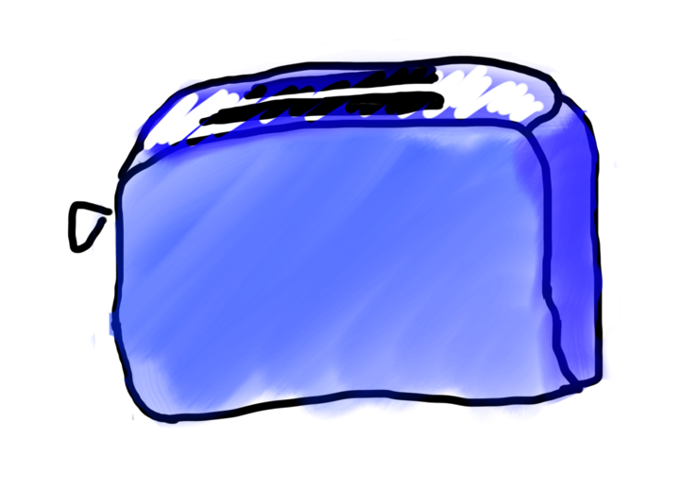
Requests are like Remote Method Calls
Server has a bunch of discrete things it can do
Server
addUser
getStatus

Slide 32
Requests are like Remote Method Calls
Server
addUser
getStatus

Slide 33
Requests are like Remote Method Calls
request.getCommand();
=> ”addUser”
Server
addUser
getStatus

Slide 34
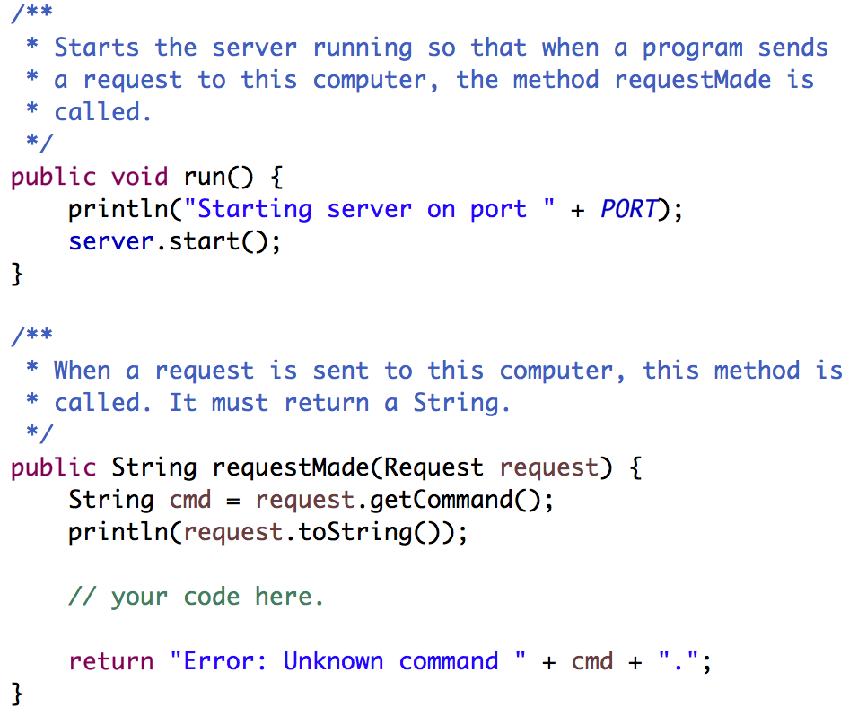
Your Server Code
Respond to requests here. The String you return will be sent as the response.
Notes:
What is a request? A way to structure messages so they’re consistent and easy to understand.

Slide 35
Where we left off...

Slide 36
There are two types of internet programs. Servers and Clients

Slide 37
Now, the client

Slide 38
A Clients’s Purpose
1. Interact with the user
2. Get data from its server
3. Save data to its server

Slide 39
Clients on one slide
try {
// 1. construct a new request
Request example = new Request("getStatus");
// 2. add parameters to the request
example.addParam("name", "chris");
// 3. send the request to a computer on the internet
String result = SimpleClient.makeRequest(HOST, example);
} catch(IOException e) {
// The internet is a fast and wild world my friend
}

Slide 40
Clients on one slide
try {
// 1. construct a new request
Request example = new Request("getStatus");
// 2. add parameters to the request
example.addParam("name", "chris");
// 3. send the request to a computer on the internet
String result = SimpleClient.makeRequest(HOST, example);
} catch(IOException e) {
// The internet is a fast and wild world my friend
}

Slide 41
Clients on one slide
try {
// 1. construct a new request
Request example = new Request("getStatus");
// 2. add parameters to the request
example.addParam("name", "chris");
// 3. send the request to a computer on the internet
String result = SimpleClient.makeRequest(HOST, example);
} catch(IOException e) {
// The internet is a fast and wild world my friend
}

Slide 42
Clients on one slide
try {
// 1. construct a new request
Request example = new Request("getStatus");
// 2. add parameters to the request
example.addParam("name", "chris");
// 3. send the request to a computer on the internet
String result = SimpleClient.makeRequest(HOST, example);
} catch(IOException e) {
// The internet is a fast and wild world my friend
}

Slide 43
Clients on one slide
try {
// 1. construct a new request
Request example = new Request("getStatus");
// 2. add parameters to the request
example.addParam("name", "chris");
// 3. send the request to a computer on the internet
String result = SimpleClient.makeRequest(HOST, example);
} catch(IOException e) {
// The internet is a fast and wild world my friend
}

Slide 44
Clients on one slide
try {
// 1. construct a new request
Request example = new Request("getStatus");
// 2. add parameters to the request
example.addParam("name", "chris");
// 3. send the request to a computer on the internet
String result = SimpleClient.makeRequest(HOST, example);
} catch(IOException e) {
// The internet is a fast and wild world my friend
}

Slide 45
Clients on one slide
try {
// 1. construct a new request
Request example = new Request("getStatus");
// 2. add parameters to the request
example.addParam("name", "chris");
// 3. send the request to a computer on the internet
String result = SimpleClient.makeRequest(HOST, example);
} catch(IOException e) {
// The internet is a fast and wild world my friend
}

Slide 46
Clients on one slide
try {
// 1. construct a new request
Request example = new Request("getStatus");
// 2. add parameters to the request
example.addParam("name", "chris");
// 3. send the request to a computer on the internet
String result = SimpleClient.makeRequest(HOST, example);
} catch(IOException e) {
// The internet is a fast and wild world my friend
}

Slide 47
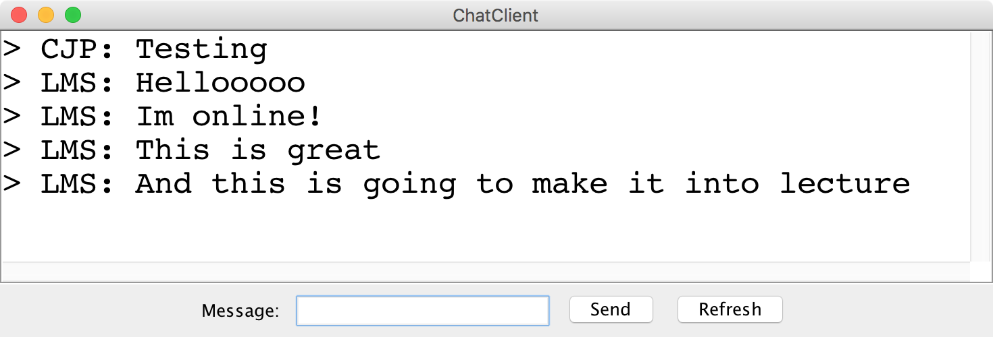
Chat Server and Client

Slide 48
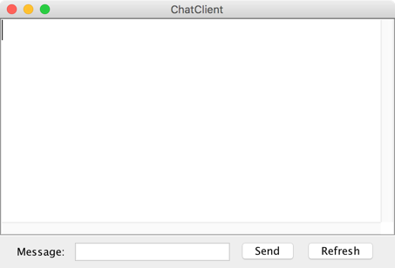
history = [
]
addMsg
msg = C: Hello world
Chat Client
Chat Client
Send
Hello world
Send

Slide 49
history = [
C: Hello world
]
getMsgs
index = 0
Chat Client
Chat Client
Send
Send

Slide 50
Chat Server
addMsg
msg = text
Chat Server
getMsgs
index = startIndex

Slide 51
There are two types of internet programs. Servers and Clients

Slide 52
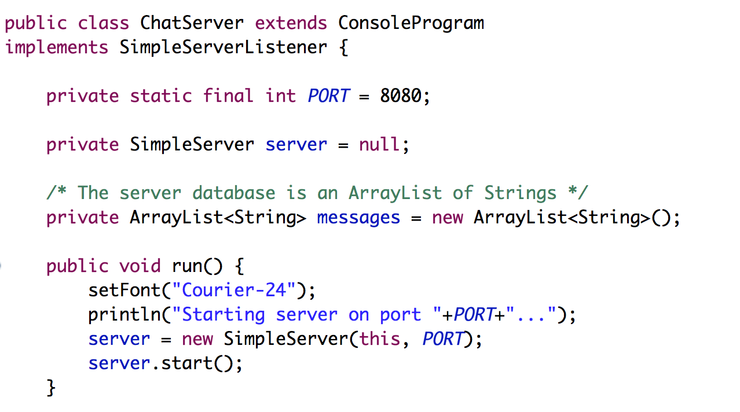
Chat Server
… that’s not all

Slide 53
Chat Server
… that’s not all

Slide 54
Chat Server
… that’s not all

Slide 55
Chat Server
… that’s not all

Slide 56
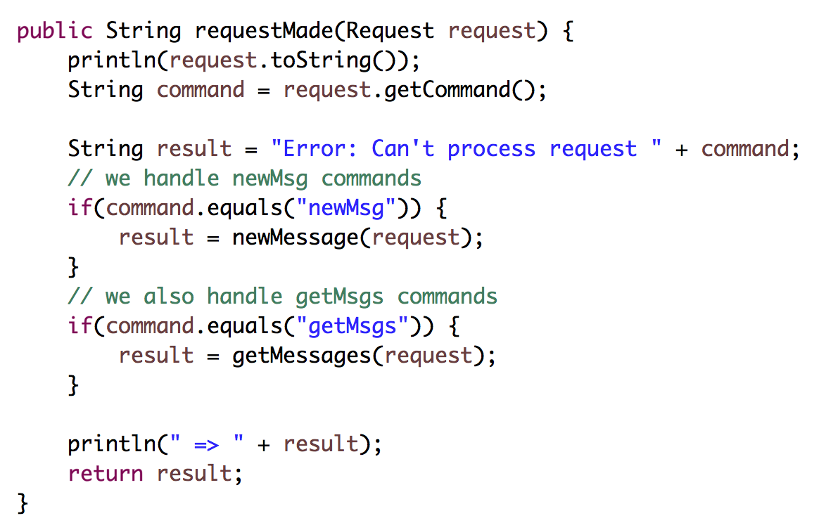
Chat Server (continued)

Slide 57
Chat Server (continued)

Slide 58
Chat Server (continued)

Slide 59
Chat Server (continued)

Slide 61
FAQ

Slide 62
Question: This is cool Chris.
But didn’t you just really
dumb down servers?

Slide 63
Answer: No

Slide 64
Question: Why isn’t this in a browser?

Slide 65
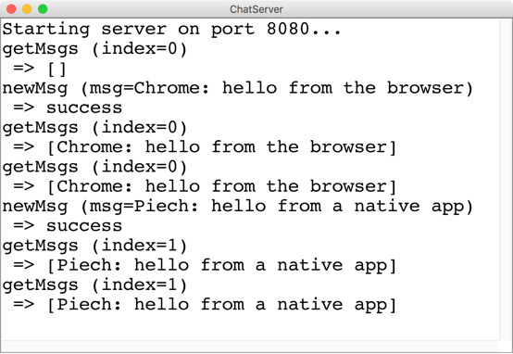
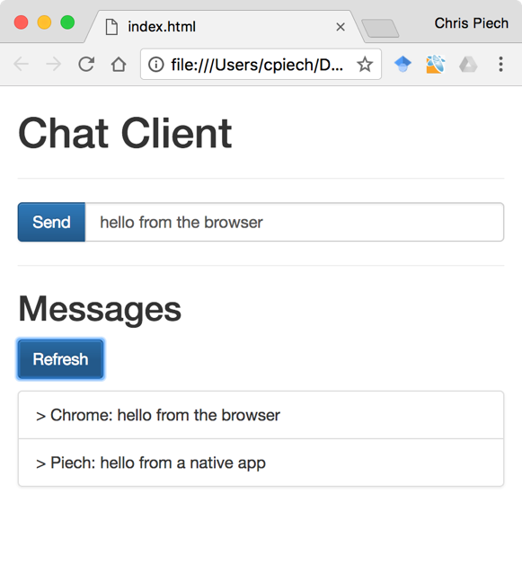
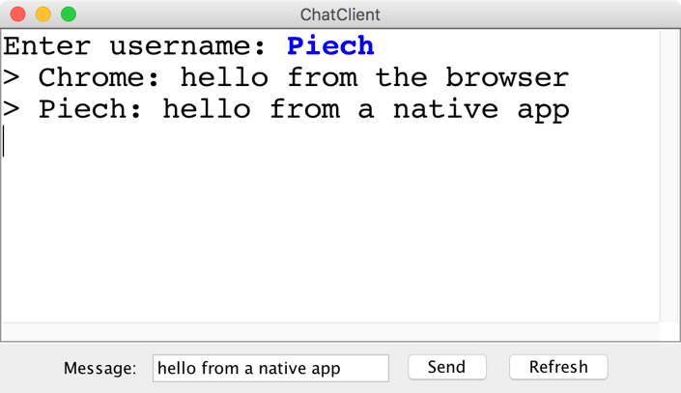
“Native” vs “Browser”

Slide 66
Question: Localhost forever?

Slide 67
Use ngrok to get a url

Slide 69
Any security holes?

Slide 70
Want to learn more?
CS144 Computer Networking
Or CS193P
Or CS193A
Or CS108

Slide 71
Social Networks

Slide 72

Who Do You Love
Who do you love?
And how does Facebook know?

Slide 73
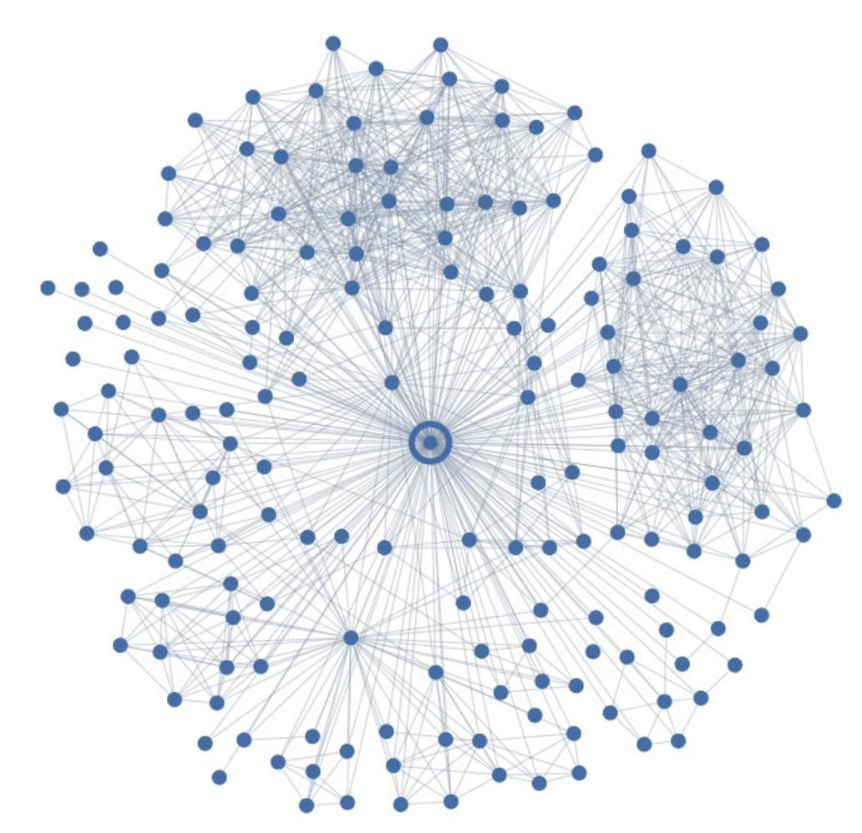
Ego Graph
Your local social network

Slide 74
Maybe I Love These People?
You have some “groups”

Slide 75
But I Actually Love This Person
But here is the love of your life
Your significant other
George

Slide 76
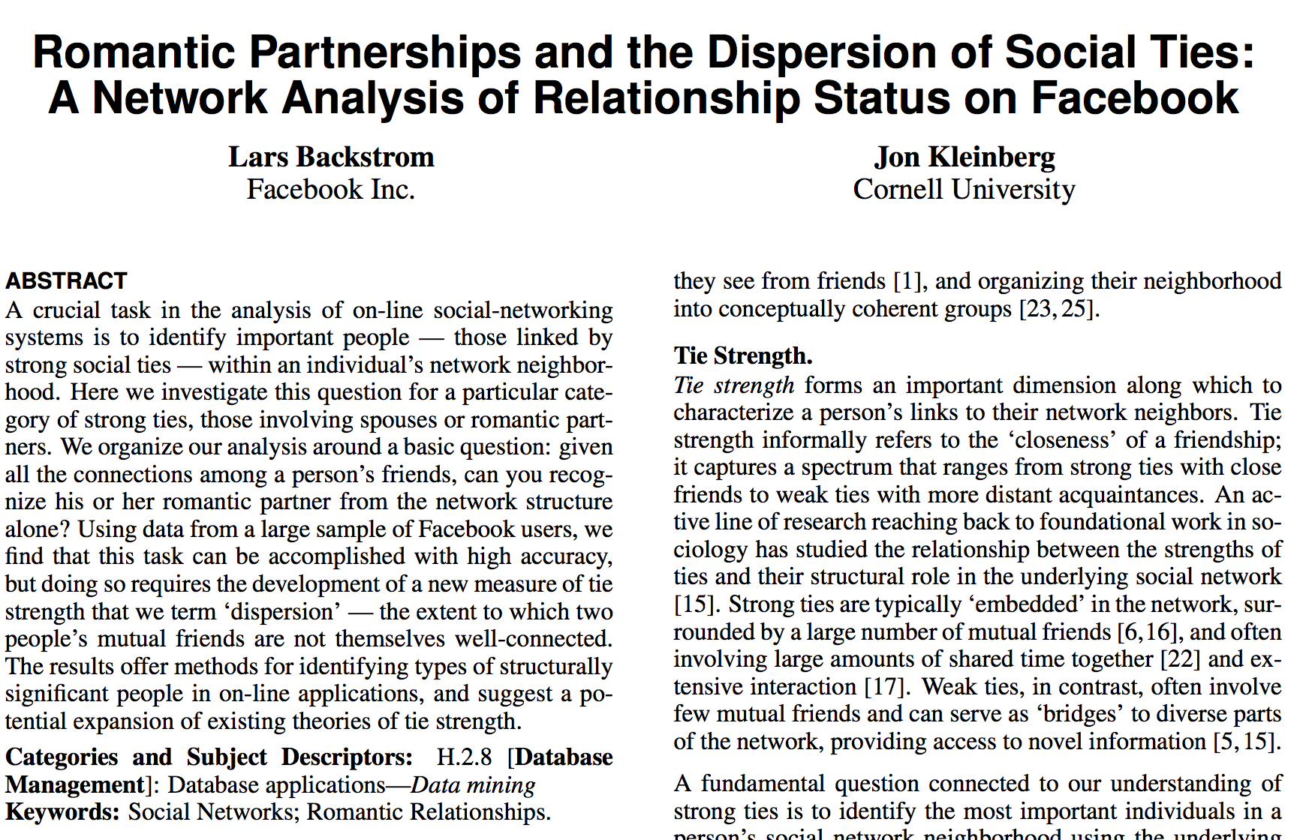
Romance and Dispersion
Romance and Social Networks
October 2013
http://arxiv.org/pdf/1310.6753v1.pdf

Slide 77
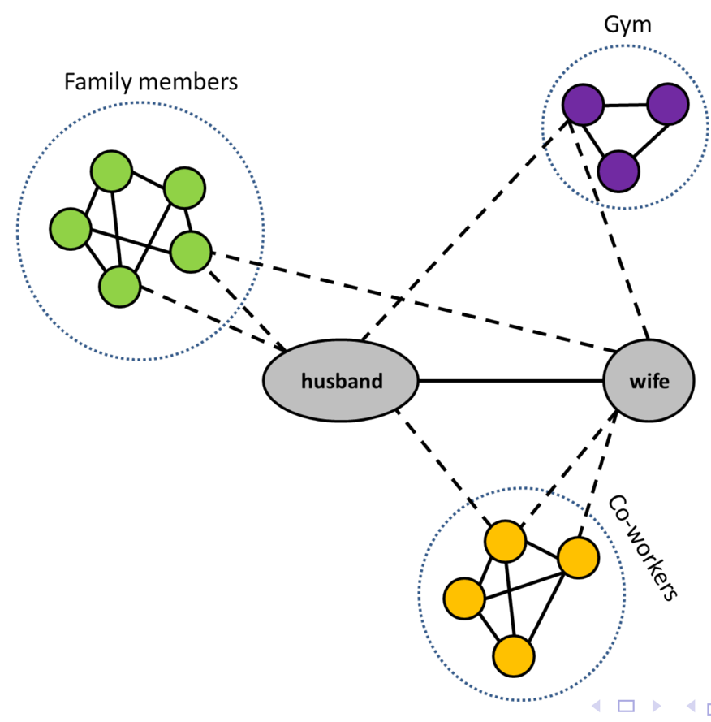
Dispersion Insight
Romance and Social Networks
Dispersion: The extent to which two people’s
mutual friends are not directly connected

Slide 78
Dispersion Insight
Mining Massive Datasets
CS246: Mining Massive Datasets
Jure Leskovec
Or CS106B or CS103 or CS109
Dispersion: The extent to which two people’s
mutual friends are not directly connected

Slide 79
filter bubble
fake news
hate speech
privacy
monopoly
Omer Reingold: Fairness Through Computationally-Bounded Awareness

Slide 80
Question
How could users could join different SteamTunnels but still connect to one another.

Slide 81
Federated Internet Applications
Professor Monica Lam

Slide 82
The end.

